Slide 1
Lecture 12-14
BT 203
Biochemistry
3-0-0-6
Prof. Ajaikumar B. Kunnumakkara
CANCER BIOLOGY LABORATORY
Department of Biosciences and Bioengineering
Indian Institute of Technology (IIT) Guwahati
Assam, INDIA

Slide 2
Key Concepts
How are nucleotides synthesized in the cells?
Precursors of nucleotides
Understand nucleotide biosynthesis pathways – a) De novo b) Salvage
De novo synthesis of purines and pyrimidines
Salvage pathways of purines and pyrimidines

Slide 3
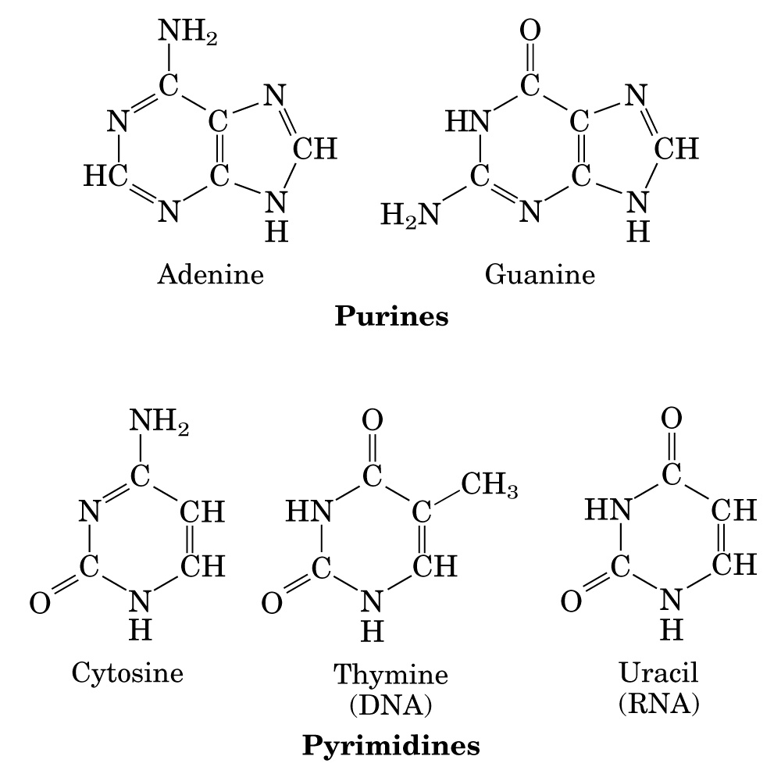
Purines and Pyrimidines
Purines and Pyrimidines: two classes of nucleotides in the cells
Purines: Adenine and Guanine
Pyrimidines: Thymine, Cytosine and Uracil
Precursors/Building blocks for DNA and RNA synthesis
Essential carriers of chemical energy, especially ATP (Energy transformation)
Components of the coenzymes NAD⁺, FAD, and coenzyme A
ATP , ADP, and AMP may function as allosteric regulators and participate in regulation of many metabolic pathways.
ATP involved in covalent modification of enzymes.

Slide 4
Nucleotides Biosynthesis
There are two pathways leading to Biosynthesis of Nucleotides
De Novo Biosynthesis:
This is a main synthetic pathway.
The biosynthesis of nucleotides begins /very new with the use of small metabolic precursors as a raw material:
Amino acids, Ribose-5-phosphate, CO2, and One-carbon units.
Salvage pathways:
The synthesis of nucleotide by recycle of the free Nitrogen bases or nucleosides released from nucleic acid breakdown.
This is important in Brain and Bone marrow

Slide 5
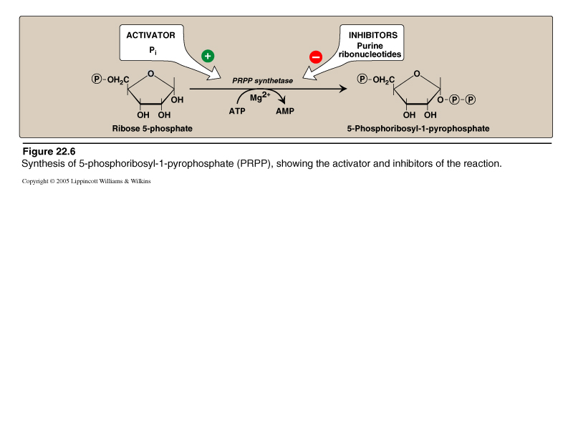
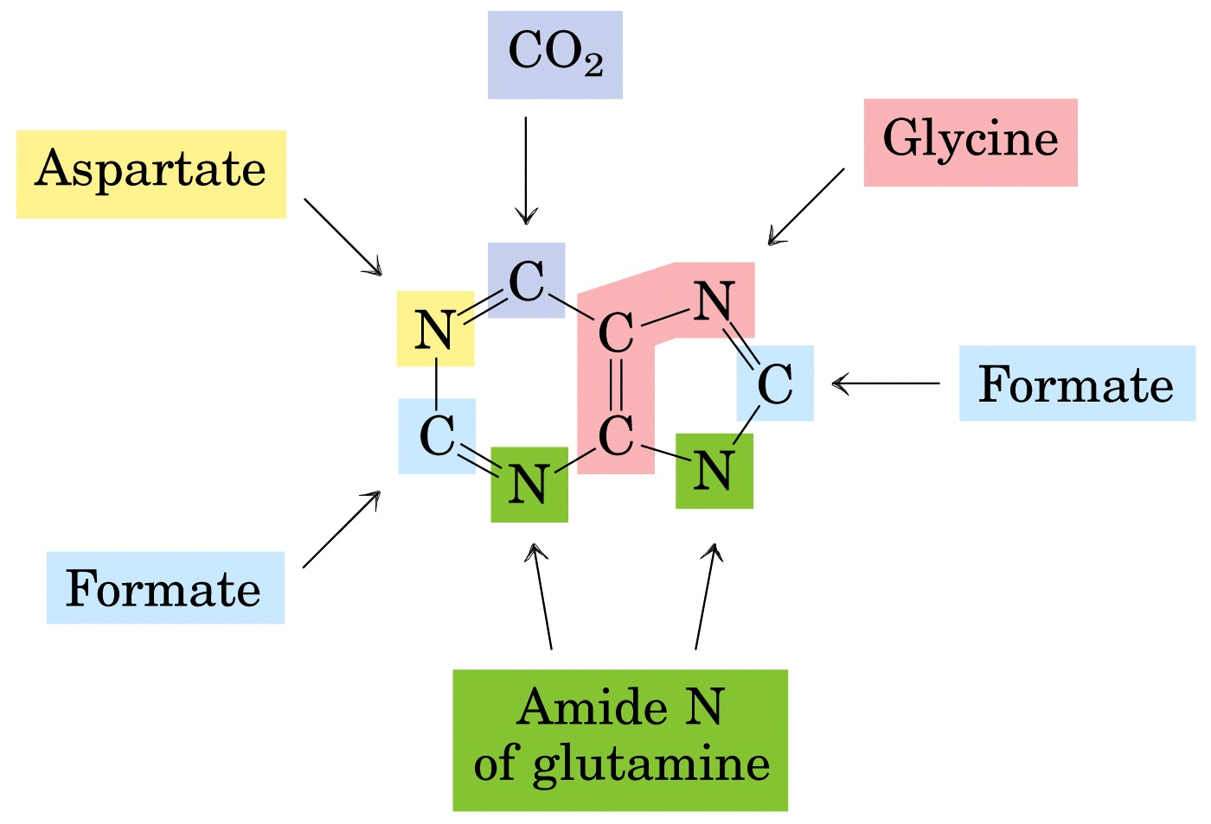
Conversion of Ribose-5-Phosphate to PRPP
Phospho Ribosyl Pyro Phosphate (PRPP) is a starting material for Purine De novo biosynthesis.
PRPP is formed from Ribose-5-Phophate.
The Pentose sugar is always a Ribose, which may be reduced to Deoxyribose after nucleotide synthesis is complete.
5-Phosphoribosyl-1-pyrophosphate (PRPP) is also involved in synthesis of Pyrimidine nucleotides, NAD⁺, and Histidine biosynthesis
The De novo biosynthesis of Purine nucleotide means a very new synthesis using raw materials as
Phosphoribose
Amino acids : Gly , Gln and Asp
One carbon units and
CO2
Nitrogen and Carbon Sources Of Purine Ring Biosynthesis
John Buchanan (1948) "traced" the sources of all nine atoms of Purine ring
N-1: Aspartic acid
N-3, N-9: Glutamine
C-2, C-8: N¹⁰-Formyl-THF- One carbon units
C-4, C-5, N-7: Glycine
C-6: CO₂
Element Sources For Purine bases
N¹⁰Formyltetrahydrofolate
N¹⁰Formyltetrahydrofolate

Slide 6
De novo Synthetic pathway-Purines
The De Novo synthetic pathway can be divided into two Stages:
Stage one : Formation of Inosine Mono Phosphate ( IMP )
Stage two : Conversion of IMP to either AMP or GMP
The De Novo synthetic pathway can be divided into two Stages:
Stage one : Formation of Inosine Mono Phosphate ( IMP )
Stage two : Conversion of IMP to either AMP or GMP
Biosynthesis of Inosine Mono Phosphate (IMP)
Basic pathway for De novo biosynthesis of Purine Ribonucleotides
Starts from Ribose-5-phosphate(R-5-P)
Requires 11 steps overall
Occurs primarily in the Liver cytosol.
Steps | Happenings
1 | Activation of PRPP
2 and 5 | Entry of Glutamine
3 | Entry of Glycine
4 and 10 | Entry Of N10THF
6 | Ring Closure
7 | Entry Of CO2
8 | Entry of Aspartate
9 | Removal of Fumarate
10 | Removal of Fumarate

Slide 7
De novo Synthetic pathway-Purines
PRPP Synthetase
Ribose 5Phosphate + ATP---------------------------→PRPP + AMP
Amidotransferase
PRPP + Glutamine ---------------------------→PRA + Glutamate
Once Phospho Ribosyl Amine (PRA) is formed , the building of the Purine ring structure begins.
In nine successive reactions the first Purine nucleotide formed is IMP .

Slide 8
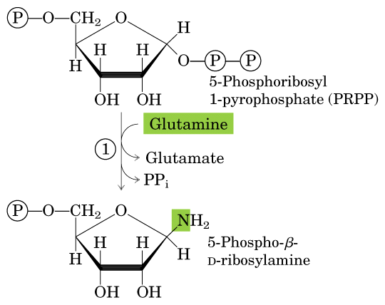
De novo Synthetic pathway-Purines
Step 1:Activation of Ribose-5-phosphate
OH
Committed/Regulatory Step
ATP
1
AMP
Ribose Phosphate Pyrophosphokinase/
PRPP Synthetase
Step 2: Acquisition of Purine atom N9
2
Gln:PRPP Amidotransferase
Steps 1 and 2 are tightly regulated by feedback inhibition
5-PRA

Slide 9
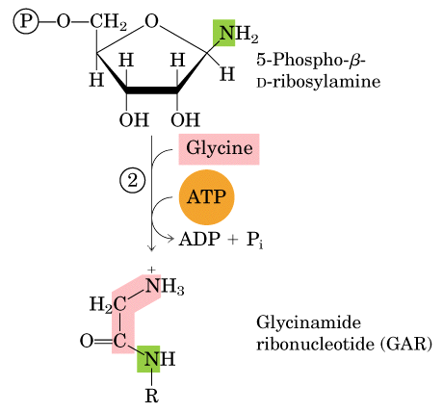
De novo synthetic pathway-Purines
Step 3: Acquisition of Purine atoms C4, C5, and N7
3

Slide 10
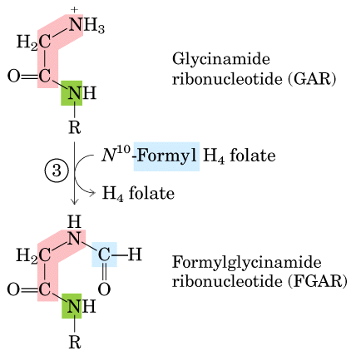
De novo synthetic pathway-Purines
Step 4: Acquisition of Purine atom C8
4

Slide 11
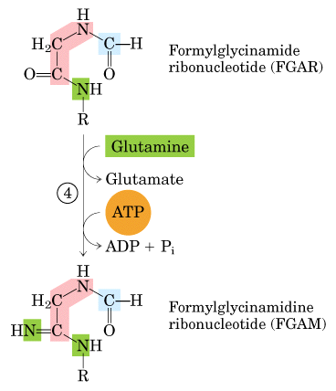
De novo synthetic pathway-Purines
Step 5: Acquisition of Purine atom N3
5

Slide 12
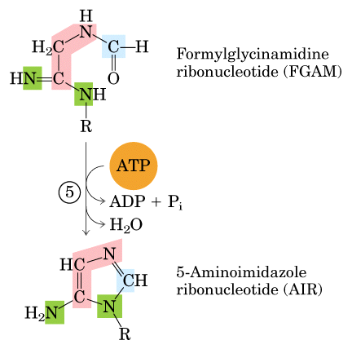
De novo synthetic pathway-Purines
Step 6: Closing of the Imidazole ring
6

Slide 13
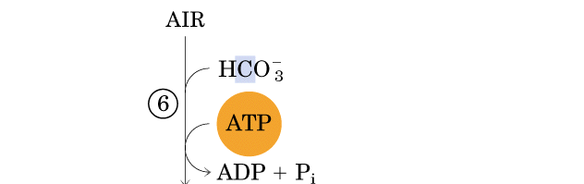
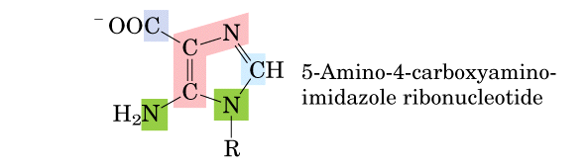
De novo synthetic pathway-Purines
Step 7: Acquisition of C6
7
Carboxyaminoimidazole
ribonucleotide (CAIR)

Slide 14
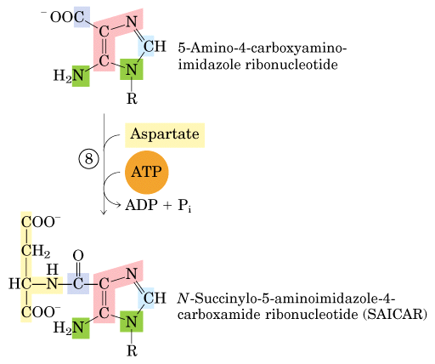
De novo synthetic pathway-Purines
Step 8: Acquisition of N1
Carboxyaminoimidazole
ribonucleotide (CAIR)

Slide 15
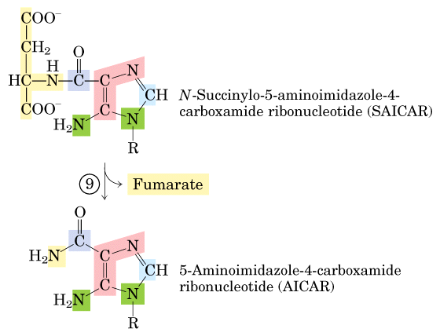
De novo synthetic pathway-Purines
Step 9: Elimination of Fumarate

Slide 16
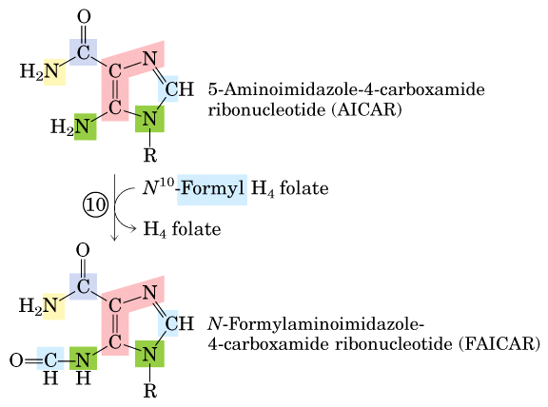
De novo synthetic pathway-Purines
Step 10: Acquisition of C2

Slide 17
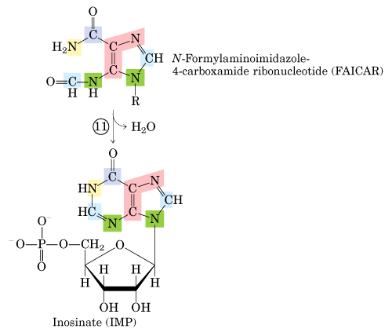
De novo synthetic pathway-Purines
Step 11: Ring Closure to form IMP

Slide 18
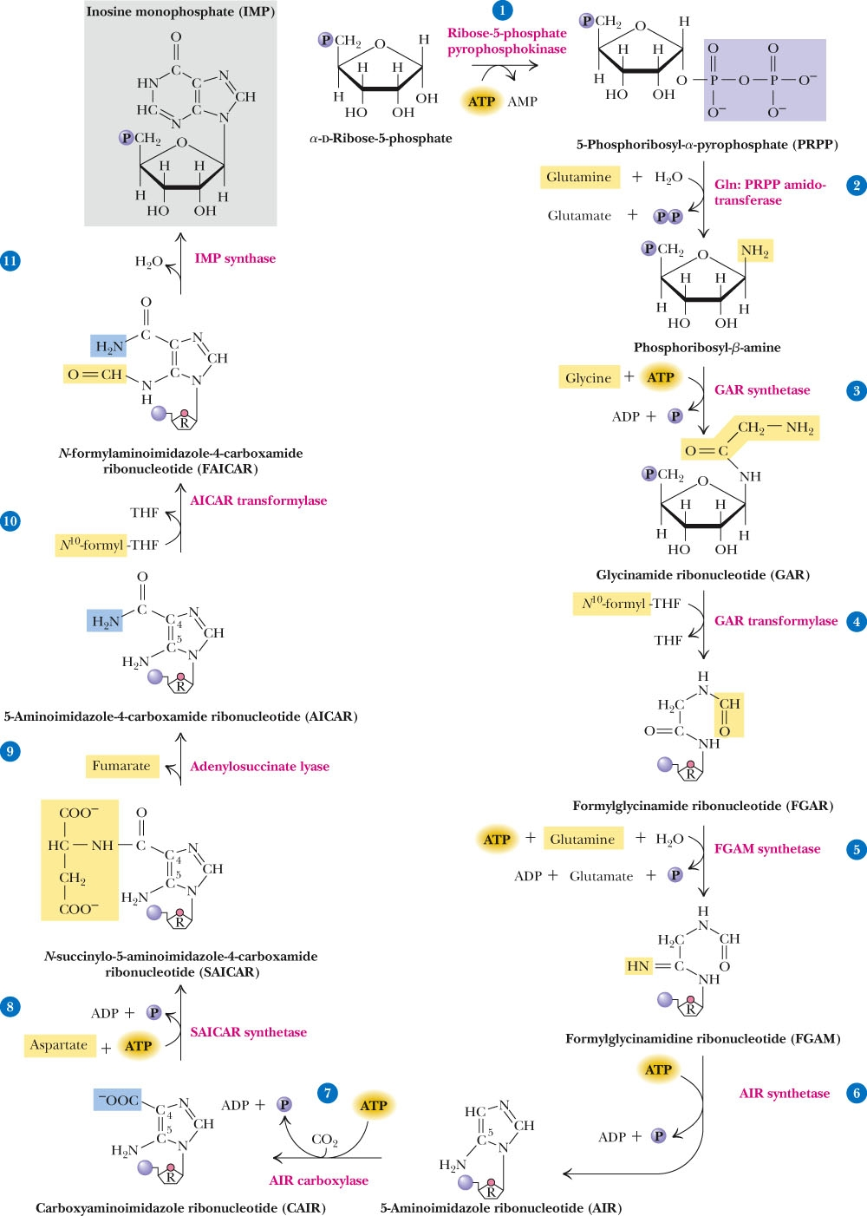
De novo synthetic pathway-Purines
IMP is a nucleotide of Nitrogen base Hypoxanthine(6 OxyPurine).
IMP is the first Purine Nucleotide synthesized in De novo Synthesis mechanism.
The De Novo pathway for Purine biosynthesis.
Step 1: Ribose-5-phosphate pyrophosphokinase.
Step 2: Glutamine phosphoribosyl pyrophosphate amidotransferase.
Step 3: Glycinamide ribonucleotide (GAR) synthetase.
Step 4: GAR transformylase.
Step 5: FGAM synthetase (FGAR amidotransferase).
Step 6: FGAM cyclase (AIR synthetase).
Step 7: AIR carboxylase.
Step 8: SAICAR synthetase.
Step 9: adenylosuccinase.
Step 10: AICAR transformylase.
Step 11: IMP synthase.

Slide 19
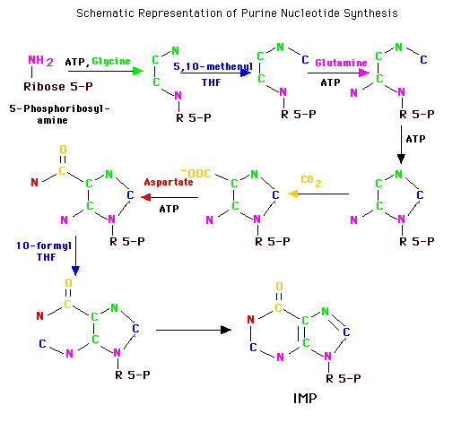
De novo synthetic pathway-Purines
N¹⁰-CHOFH₄
N¹⁰-CHOFH₄
6 ATPs are required in the Purine biosynthesis from Ribose-5-phosphate to IMP.
Since in one step ATP is converted to AMP.
Hence this is 7 ATP equivalents.

Slide 20
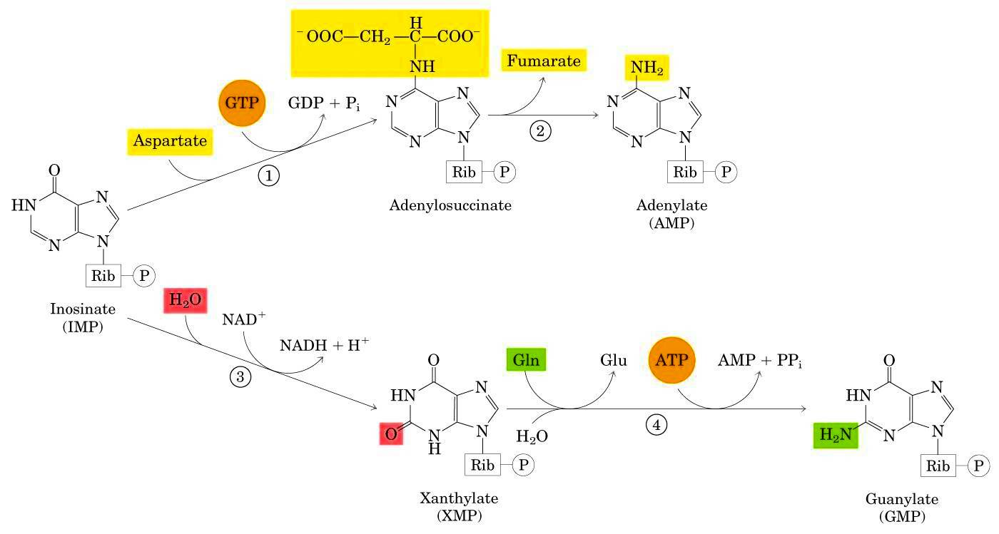
De novo synthetic pathway-Purines
Conversion of IMP to AMP and GMP
Aspartate and GTP is used for AMP synthesis
ADP, ATP, GDP and GTP Biosynthesis
kinase
kinase
ADP
ATP
AMP
ATP
ADP
ADP
ATP
kinase
kinase
GMP
GDP
GTP
ATP
ADP
ATP
ADP

Slide 21
Regulation of Purine Nucleotide Biosynthesis
Purine Nucleotide biosynthesis is well regulated to meet the cellular demand
Two enzymes are the key regulatory enzymes for the Purine Nucleotide De novo biosynthesis.
PRPP Synthase synthesizing PRPP (Phosphoribosyl Phosphate).
PRPP is “Feed-forward” activator
PRPP Glutamyl Amidotransferase
The intracellular concentration of PRPP regulates the Purine biosynthesis to large extent
More availability of PRPP increases more synthesis of Purine nucleotides if the enzyme PRPP Synthetase is not inhibited by feed back control.
IMP, AMP and GMP availability to sufficient concentration inhibits the regulatory enzymes by feed back mechanism.
PRPP activates PRPP Glutamyl Amidotransferase, IMP , AMP and GMP inhibit PRPP synthetase
Sufficient AMP:
Inhibits conversion of IMP to AMP
Sufficient GMP :
Inhibits conversion of IMP to GMP
Regulation of AMP synthesis:
Adenylosuccinate synthetase is feedback-inhibited by AMP
Regulation of GMP synthesis:
IMP Dehydrogenase is feedback-inhibited by GMP
ATP stimulates conversion of IMP to GMP
GTP stimulates conversion of IMP to AMP.
That ensures a balanced synthesis of both families of Purine nucleotides.

Slide 22
Purine Nucleotide Biosynthesis
Meet the sufficient need of the nucleotides to body function, without wasting.
AMP and GMP control their respective synthesis from IMP by a feedback mechanism, [GTP]=[ATP]

Slide 23
De novo synthetic pathway-Pyrimidines
There are also two synthesis pathways of Pyrimidine nucleotides:
De novo Synthesis and Salvage pathway
In De novo pathway the Pyrimidine ring is assembled first and then linked to Ribose phosphate
The carbon and nitrogen atoms in the Pyrimidine ring are derived from:
Bicarbonate
Aspartate
Glutamine
Shorter pathway than for Purine Synthesis Pyrimidine ring is made first, then attached to ribose-P (unlike Purine biosynthesis)
Pyrimidine Denovo synthesis requires 6 steps (instead of 11 steps for Purine)
The product is UMP (Uridine Monophosphate)
Only 3 precursors are used for Pyrimidine Denovo synthesis.
These contribute to the 6-membered ring
Aspartate
Glutamine
HCO₃⁻
Pyrimidine Ring System
Element Sources of Pyrimidine base

Slide 24
De novo synthetic pathway-Pyrimidines
Pyrimidine Biosynthesis involves 2 ATPs
Steps | Happenings
1 | Entry of CO2 and Glutamine
2 | Entry of Aspartate
3 | Ring Closure with Dehydration
4 | Oxidation of Di Hydro Orotate
5 | Entry of PRPP
6 | Decarboxylation To form UMP

Slide 25
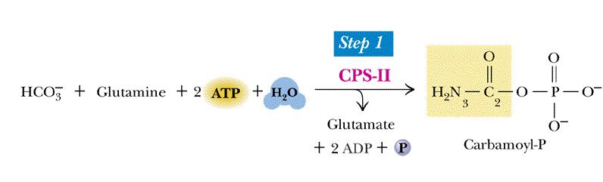
De novo synthetic pathway-Pyrimidines
Step 1: Synthesis of Carbamoyl Phosphate
Carbamoyl phosphate synthetase(CPS) exists in 2 types:
CPS-I, a mitochondrial enzyme, is dedicated to the urea cycle and arginine biosynthesis.
CPS-II, a Cytosolic enzyme, used here. It is the committed step in animals.

Slide 26
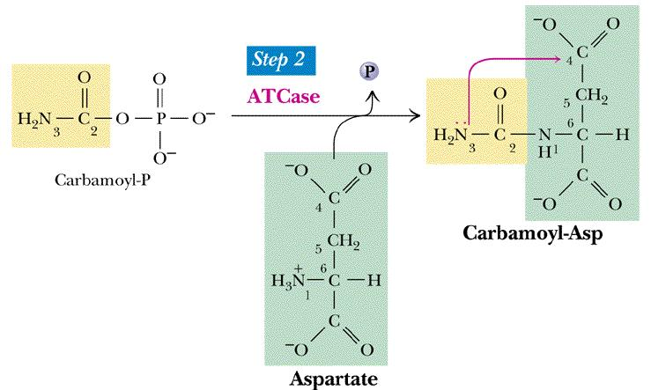
De novo synthetic pathway-Pyrimidines
Step 2: Synthesis of Carbamoyl Aspartate
ATCase: Aspartate Transcarbamoylase
Carbamoyl phosphate is an “activated” compound, so no energy input is needed at this step.

Slide 27
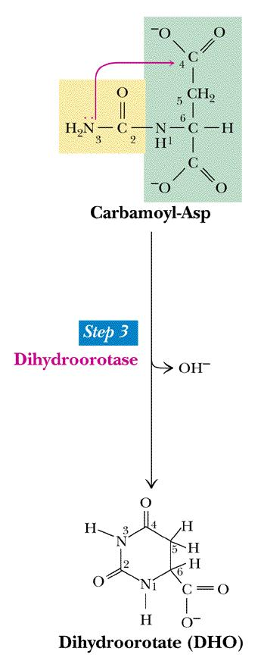
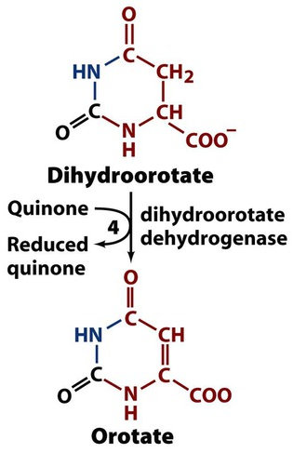
De novo synthetic pathway-Pyrimidines
Step 4:
Oxidation of DihydroOrotate To Orotate
Step 3: Ring closure to form DihydroOrotate

Slide 28
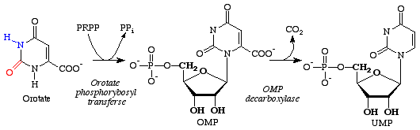
De novo synthetic pathway-Pyrimidines
Step 5: Acquisition of Ribose Phosphate moiety

Slide 29
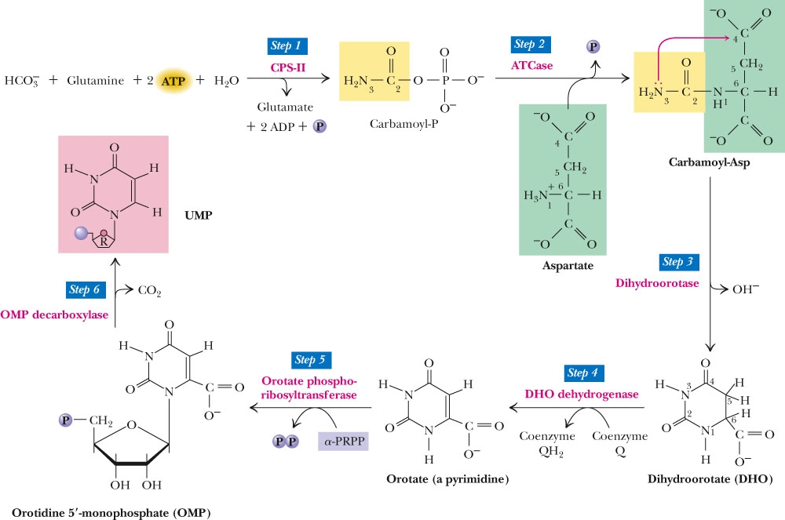
De novo synthetic pathway-Pyrimidines
Step 6: Decarboxylation of OMP OMP is decarboxylated to UMP

Slide 30
De novo synthetic pathway-Pyrimidines
Summary of pyrimidine biosynthesis
UMP

Slide 31
Salvage Pathway of Purine Nucleotides
Salvage pathway have mechanisms to retrieve Purine bases and Purine nucleosides. They are used to synthesize Purine nucleotides.
Purine bases created by degradation of RNA or DNA and intermediate of purine synthesis can be directly converted to the corresponding nucleotides.
The significance of salvage pathway :
Save the fuel.
Some tissues and organs such as brain and bone marrow are only capable of synthesizing nucleotides by salvage pathway.
Two Phosphoribosyl transferases are involved:
APRTase
(Adenine phosphoribosyl transferase) for Adenine.
HGPRTase
(Hypoxanthine guanine phosphoribosyl transferase) for guanine or Hypoxanthine.
APRTase
Adenine + PRPP--------------------------------→AMP + ppi
HGPRTase
Hypoxanthine + PRPP--------------------------------→ IMP + ppi
HGPRTase
Guanine + PRPP--------------------------------→GMP + ppi

Slide 32
Salvage Pathway of Pyrimidine Nucleotides
From Nucleoside to Nucleotide
AR kinase
Adenine Ribose + ATP--------------------------------→AMP + ADP
In comparison to De novo pathway, salvage pathway is energy-saving.
In brain and bone marrow tissues salvage pathway is the only pathway of nucleotide synthesis
Pyrimidine Phosphoribosyl Transferase (PPRTase) catalyzes the following Salvage reaction.
Uracil + PRPP- ---→ UMP + ppi
In some organisms, free Pyrimidines are salvaged and recycled to form Pyrimidine nucleotides
In humans, Pyrimidines are recycled from Nucleosides, but free Pyrimidine bases are not salvaged
Uridine Kinase catalyzes the formation of UMP from Uridine and ATP.
UR + ATP-------→ UMP + ADP

Slide 33
Highlights
Character | Purines De Novo Synthesis | Pyrimidines De Novo Synthesis
Number Of Steps Involved | 11 Steps | 6 Steps
Precursors Of Ring | Amino acids :Asp Gly and Gln N10FormylTHF CO2 | Amino acids :Asp and Gln CO2
Major Portion Of Ring provided by | Glycine | Aspartate
Acquisition of Ribose-Phosphate | In Starting Steps | In End Steps
Formation of N-Glycosidic bond | In 1st step of their biosynthesis (PRPP is the 1st Substrate) | a heterocyclic ring is formed first, then it reacts with PRPP
Number Of ATPs Involved | 6 ATPs | 2ATPs
Nucleotide Produced in End | IMP | UMP
Ring Closure At | 6 and 11 steps | 3rd Step

